Slide 1

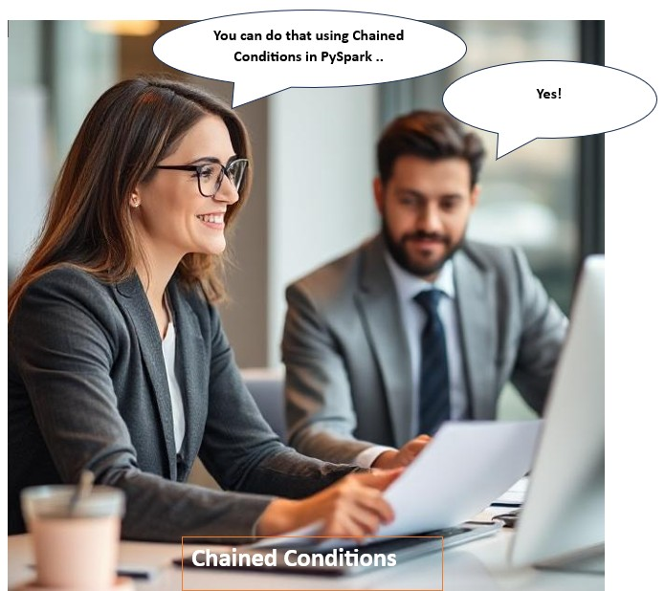
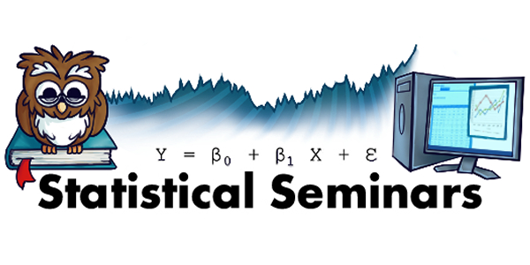

Slide 2
Agenda
About Spark
PySpark
Chained Conditions
Why are chained conditions important to know

Slide 3
PySpark
Chained conditions refer to combining multiple conditions in a single logical statement using logical operators like:
And (both conditions must be true) "&"
Or (at least one condition must be true) "|"
Not (negates the condition) "~"

Slide 4
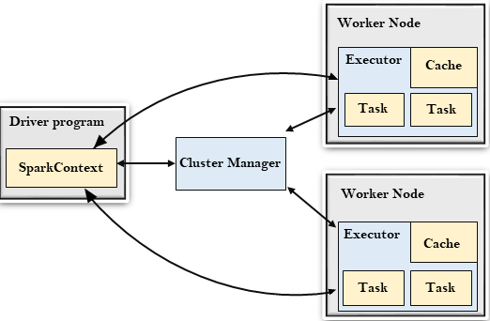
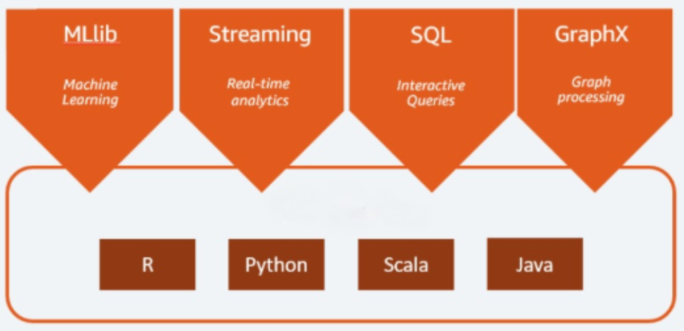
What is Apache Spark
Apache Spark is an open-source distributed cluster-computing framework introduced by Apache Software Foundation.

Slide 5
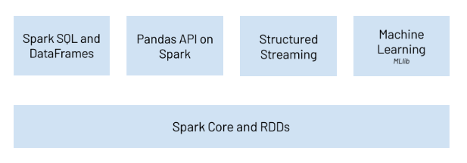
PySpark
& ML

Slide 6
PySpark - Dataframe
Schema-based: Each column has a name and a data type.
Distributed computing: DataFrames can be processed in parallel across a cluster using Spark’s execution engine.
Lazy Evaluation: Computation is only triggered when an action (like .show() or .collect()) is called.
Optimized Execution: Uses Spark’s Catalyst optimizer and Tungsten execution engine for performance.

Slide 7
Chained conditions
Chained conditions refer to combining multiple conditions in a single logical statement using logical operators like:
And (both conditions must be true) "&"
Or (at least one condition must be true) "|"
Not (negates the condition) "~"

Slide 8
Why is this important
They allow developers to create more precise output by combining multiple criteria. This is essential in real-world problem solving, where decisions often depend on more than one factor.

Slide 9
Supports Advanced Analytics and Insights
Chained conditions enable nuanced analysis, such as:
Classifying customer behavior
Detecting fraud
Prioritizing leads or support tickets
Monitoring service usage patterns

